Slide 1
Feasibility Study and Cost Estimation
Happifier- Team 5

Slide 2
FEASIBILITY STUDY

Slide 3
TECHNICAL FEASIBILITY
Is the proposed solution practical?
Yes, the idea is practical. It has a doable solution and its implementation solves a problem faced by several SNU students on a day-to-day basis.
2. What kinds of technology will be needed?
Android, Firebase, React, Redux, Thunk are few of the platforms that will be used to create the project.
Do we possess the necessary technical expertise?
Yes, at least one of our group members has worked previously on each of the above technologies. We might opt for a top-down approach to break the project into several small parts, find solutions to solve them and put them together.
Will it be compatible with other systems?
Initially, we will be working only on android; so our app cannot be used by iOS users.Due to time constraints, we are opting for this option. This way, we’ll also be able to test out app before launching it on iOS. We are also working on a website to cater to ALL users.
3. What technical risk is there?
Some bugs might go unnoticed if sufficient testing is not done. Also there might be issues if the app is not compatible with all android versions. Such situations will be dealt with as much precision as possible.

Slide 4
ECONOMICAL FEASIBILITY
Is the project possible, given resource(i.e money)?
This project is economically feasible, since the version we’re aiming to finish in the next 3 months doesn’t require any pay-and-use platform. Once we have a test run on the campus, we can use it to advertise psychologists’ services.
What is the minimal cost to build up the final project?
We are using open source softwares so there is no cost of production.
What are the benefits?
This portal could be used on a regular basis by SNU students for free and by mental health services to advertise their services at a nominal cost .
Will the benefits outweigh costs?
Yes, the benefits will outweigh the cost because of share basis with the vendors
How soon will the benefits acure?
This can be estimated once the app is in use. We would have to estimate based on the reach and frequency of the portal.

Slide 5
SCHEDULING FEASIBILITY
How long will it take all the members to gain the technical expertise needed for this project?
Every member of the group has a fair level of working knowledge of all platforms being put to use. Based on our learning curve and time devoted, the members will be able to implement on more platform as the project moves onto better versions.
Is it possible to complete the project within the deadline?
Yes, the project can be completed within the deadline as we have a time plan for all the features to be implemented in our app
What are the consequences of delay?
Since the product isn’t a deliverable promised to a certain party, the delay won’t have any major consequences. Our aim is to present a finished product with the main features at the end of the semester. The remaining features will/can be added as and when required, after due consideration over the inputs provided by the faculty/students.
3. What are the real constraints on the project deadline?
Missed schedules are bad, but inadequate solution is worst. Thus, the real constraint is the creation of a project that is an adequate solution, with minimal bugs (if any) and doing it within 3 months.

Slide 6
SCHEDULING FEASIBILITY
Sprint 1 starts
Sprint 2 starts
Sprint 3 starts
MAR 8
April 8
April 21
FEB 15
Mar 18
April 11
Sprint 1 ends
Sprint 2 ends
Sprint 3 ends

Slide 7
OPERATIONAL FEASIBILITY
If the system is developed, will it be used?
We have high hopes, given the kind of response we have received when taking inputs from the students/Blue Circle, we believe there is a huge need for such a portal. The current solutions are not up to the mark and scattered, and our consolidated platform aims to solve that problem.
How do the end-users (i.e the psychologists and students) feel about the project?
We spoke to Blue Circle and students about this project and they look forward to this app being in use.
Which users may not use the app?
With a lot of stigma still attached to mental health, we are afraid a few students might not use this app.
How will the environment for the students change?
We think that a major change in the outlook towards mental health will occur. With the marketing that this product will entail, we hope to make talking about depression and anxiety more acceptable. Another benefit would be a smoother operation of Blue Circle. The current website has high latency and crashes often, making booking appointments a nightmare.
Can all stakeholders adapt to these changes?
Given how enthusiastic and supporting everyone’s about the introduction of Happifier and how easy to use it is, we’re sure that both Blue Circle and the students will adapt to the changes. Also, we as a team, will help them ease into the app, for better consumer experience.

Slide 8
COST ESTIMATION

Slide 9
FUNCTION POINTS

Slide 10
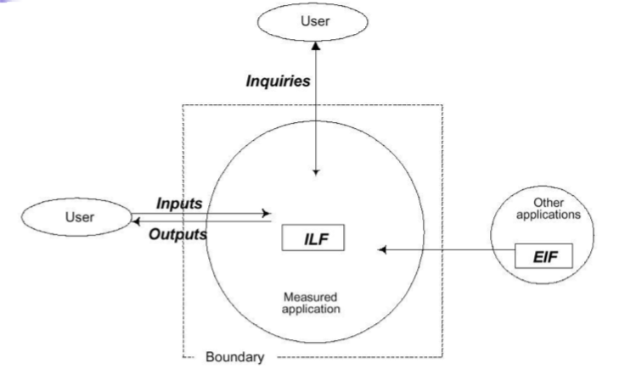
WHY FUNCTION POINT?
It is independent of programming language, technology, techniques.
They can be used for GUI systems.
It can be applied at early stage in software development.
Creation of more function points can define productivity goal as opposed to LOC.

